Slide 1
EDGE COMPUTER VISION • RF DSP
YOLOv8 RF Spectrogram & Satcom Detector
Transforming 50 MSPS raw baseband I/Q streams into 2048-pt STFT matrices for sub-4ms neural classification.

Slide 2
SPECTRAL TRANSFORMATION
Signal Space Conversion
50 MSPS
2048-pt
-6 dB
Continuous baseband I/Q ingestion.
STFT Hanning waterfall resolution.
Noise floor multi-path tolerance.

Slide 3
EDGE INFERENCE
TensorRT Quantized Pipeline
STFT DSP Conversion
YOLOv8 Backbone
Satcom Protocol Layer
Vectorized frequency-time matrix.
Hopping pattern bounding boxes.
Downlink protocol classification.

Slide 4

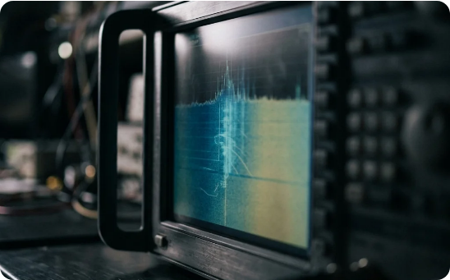
MODULATION INVENTORY
Satellite Communications & Telemetry Classification
FHSS Telemetry: Isolates frequency hopping quadcopters from Wi-Fi.
Downlink Bursts: Detects L-band and S-band satcom frames.
Modulation Profiles: FSK, QPSK, OFDM classification.

Slide 5
EDGE BENCHMARKS
Inference Speed & Accuracy
3.8 ms
TensorRT FP16 inference loop on embedded edge accelerator
Classification Accuracy: 96.8% under noise
Throughput: 240+ waterfall FPS

Slide 6
REAL-TIME SIGNAL PERCEPTION
Bridging RF Signal Spaces and Neural Vision
Sub-millisecond protocol classification and spectrum awareness at the tactical edge.

Slide 7

Image Sources
https://rfessentials.com/images/waterfall-analyzer-hero.webp
Source: rfessentials.com

